Slide 1
Excel Functions
Functions
Excel has many premade formulas, called functions.
Functions are typed by = and the functions name.
For example =SUM
Once you have typed the function name you need to apply it to a range.
For example =SUM(A1:A5)

Slide 2
Excel Functions
=AND | Returns TRUE or FALSE based on two or more conditions
=AVERAGE | Calculates the average (arithmetic mean)
=AVERAGEIF | Calculates the average of a range based on a TRUE or FALSE condition
=AVERAGEIFS | Calculates the average of a range based on one or more TRUE/FALSE conditions
=CONCAT | Links together the content of multiple cells
=COUNT | Counts cells with numbers in a range
=COUNTA | Counts all cells in a range that has values, both numbers and letters
=COUNTBLANK | Counts blank cells in a range
=COUNTIF | Counts cells as specified
=COUNTIFS | Counts cells in a range based on one or more TRUE or FALSE condition
=IF | Returns values based on a TRUE or FALSE condition
=IFS | Returns values based on one or more TRUE or FALSE conditions
=LEFT | Returns values from the left side of a cell
=LOWER | Reformats content to lowercase
=MAX | Returns the highest value in a range
=MEDIAN | Returns the middle value in the data
=MIN | Returns the lowest value in a range
=MODE | Finds the number seen most times. The function always returns a single number
=NPV | The NPV function is used to calculate the Net Present Value (NPV)
=OR | Returns TRUE or FALSE based on two or more conditions
=RAND | Generates a random number
=RIGHT | Returns values from the right side of a cell
=STDEV.P | Calculates the Standard Deviation (Std) for the entire population
=STDEV.S | Calculates the Standard Deviation (Std) for a sample
=SUM | Adds together numbers in a range
=SUMIF | Calculates the sum of values in a range based on a TRUE or FALSE condition
=SUMIFS | Calculates the sum of a range based on one or more TRUE or FALSE condition
=TRIM | Removes irregular spacing, leaving one space between each value
=VLOOKUP | Allows vertical searches for values in a table
=XOR | Returns TRUE or FALSE based on two or more conditions

Slide 3
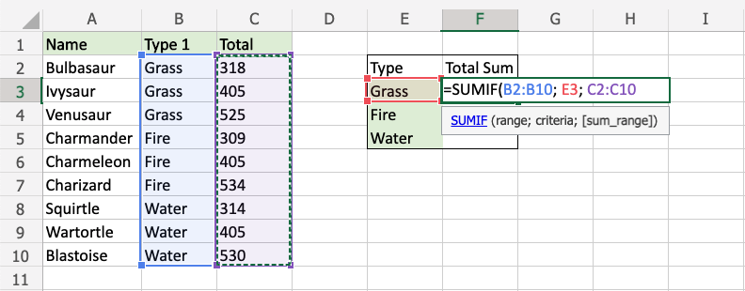
SUMIF
The SUMIF function is a premade function in Excel, which calculates the sum of values in a range based on a true or false condition.
It is typed =SUMIF:
=SUMIF(range, criteria, [sum_range])
The condition is referred to as criteria, which can check things like:
If a number is greater than another number >
If a number is smaller than another number <
If a number or text is equal to something =
The [sum_range] is the range where the function calculates the sum.

Slide 4
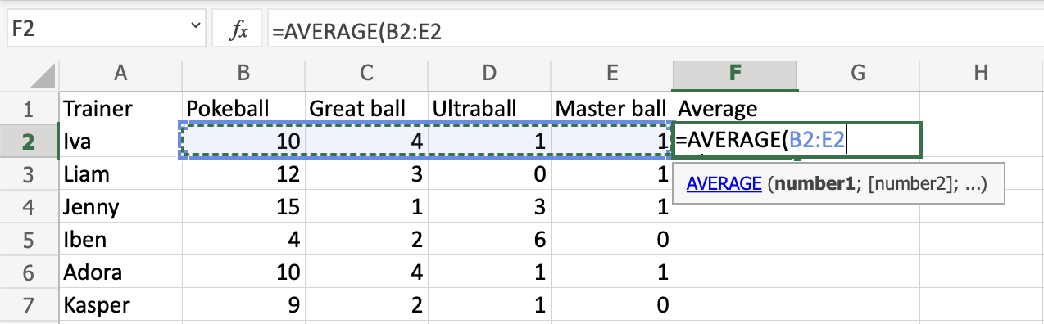
AVERAGE Function
The AVERAGE function is a premade function in Excel, which calculates the average (arithmetic mean).
It is typed =AVERAGE
It adds the range and divides it by the number of observations.
Example:
The average of (2, 3, 4) is 3. 3 observations (2, 3 and 4) The sum of the observations (2 + 3 + 4 = 9) (9 / 3 = 3) The average is 3

Slide 5
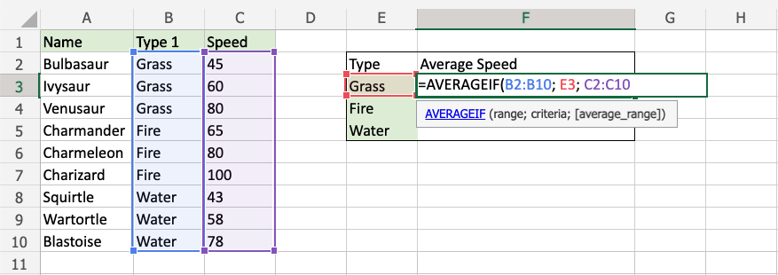
AVERAGEIF Function
The AVERAGEIF function is a premade function in Excel, which calculates the average of a range based on a true or false condition.
It is typed =AVERAGEIF and has three parts:
=AVERAGEIF(range, criteria, [average_range])
The condition is referred to as criteria, which can check things like:
If a number is greater than another number >
If a number is smaller than another number <
If a number or text is equal to something =
The [average_range] is the range where the function calculates the average.

Slide 6
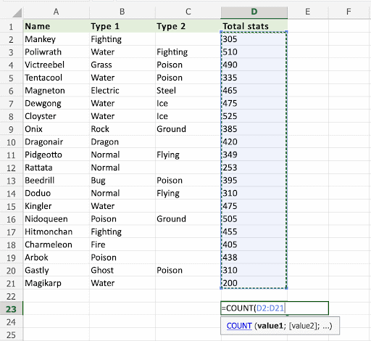
COUNT Function
The COUNT function is a premade function in Excel, which counts cells with numbers in a range.
It is typed =COUNT
Note: The COUNT function only counts cells with numbers, not cells with letters. The COUNTA function is better used if the cells have letters.
How to use the =COUNT function:
Select a cell
Type =COUNT
Double click the COUNT command
Select a range
Hit enter
Let's see some examples!
Apply the =COUNT function to range D2:D21. Counting the cells of Pokemon Total stats, which
is numbers only:

Slide 7
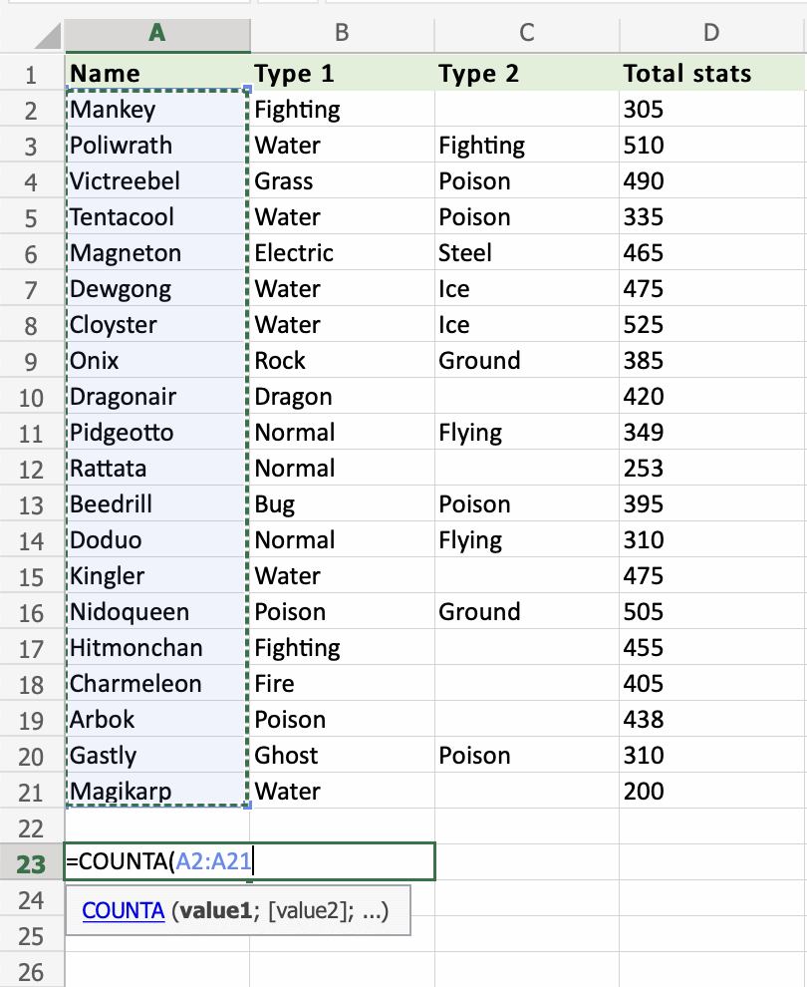
COUNTA Function
The COUNTA function is a premade function in Excel, which counts all cells in a range that has
values, both numbers and letters.
It is typed =COUNTA
How to use the =COUNTA function:
Select a cell
Type =COUNTA
Double click the COUNTA command
Select a range
Hit enter
Let's see some examples!
Apply the =COUNTA function to range A2:A21, counting Pokemons by their names,
which are letters only:

Slide 8
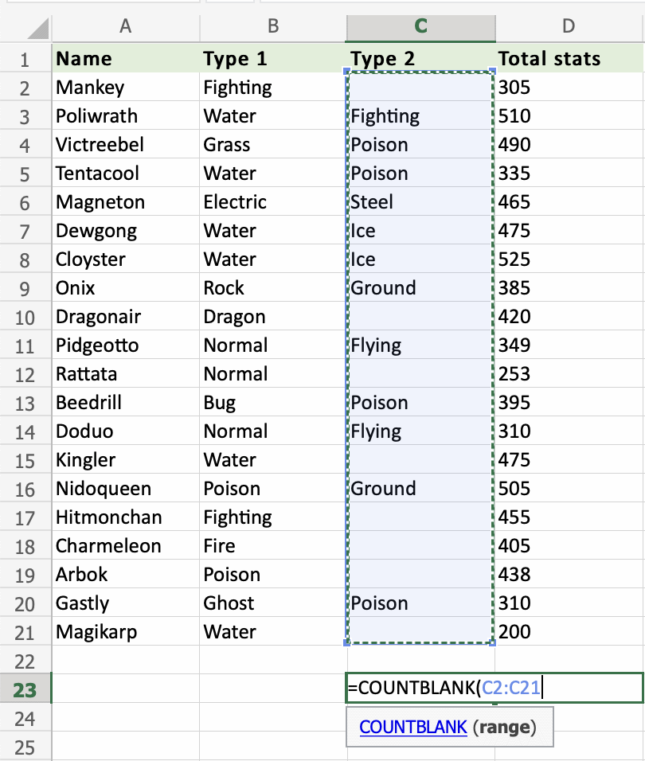
COUNTBLANK Function
The COUNTBLANK function is a premade function in Excel, which counts blank cells in a range.
It is typed =COUNTBLANK
Note: The COUNTBLANK function is helpful to find empty cells in a range.
How to use the =COUNTBLANK function:
Select a cell
Type =COUNTBLANK
Double click the COUNTBLANK command
Select a range
Hit enter
Let's see some examples!
Apply the =COUNTBLANK function to range C2:C21, to find the Pokemons which do not have a
2nd Type:

Slide 9
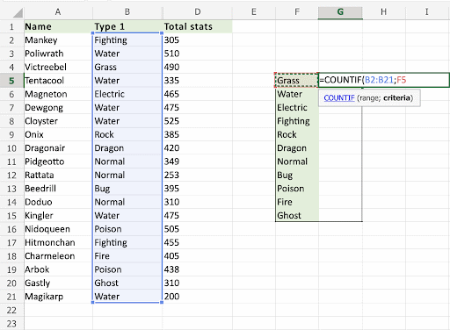
COUNTIF Function
The COUNTIF function is a premade function in Excel, which counts cells as specified.
It is typed =COUNTIF
NOTE: The COUNTIF function can have basic or more advanced uses. This covers the basic use for how to count specific numbers and words.
Numbers (e.g. 90) and words (e.g. "Water") can be specified.
How to use the =COUNTIF function:
Select a cell
Type =COUNTIF
Double click the COUNTIF command
Select a range
Type ,
Select a cell (the criteria, the value that you want to count)
Hit enter

Slide 10
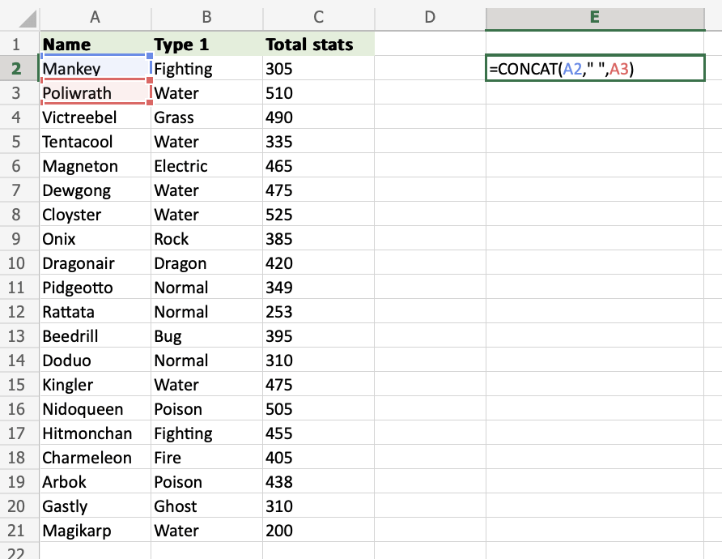
CONCAT Function
To concatenate is to link something together.
CONCAT is a function in Excel and is short for concatenate.
The CONCAT function is used to link multiple cells without adding any delimiters between the combined cell values.
It is typed =CONCAT
=CONCAT(cell1, delimiter, cell2)

Slide 11
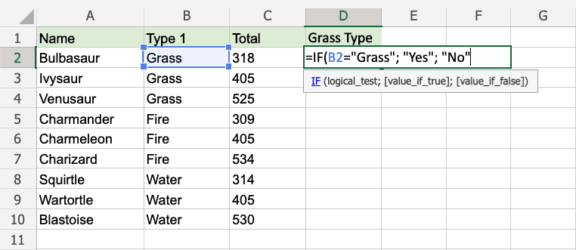
IF Function
The IF function is a premade function in Excel, which returns values based on a true or false condition.
It is typed =IF and has 3 parts:
=IF(logical_test, [value_if_true], [value_if_false])
The condition is referred to as logical_test, which can check things like:
If a number is greater than another number >
If a number is smaller than another number <
If a number or text is equal to something =

Slide 12
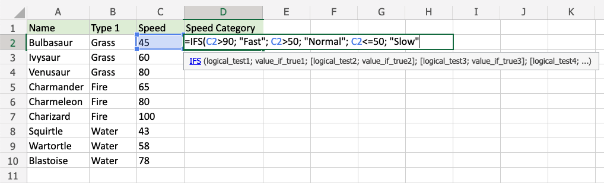
IFS Function
The IFS function is a premade function in Excel, which returns values based on one or more true or false conditions.
It is typed =IFS and has two or more parts:
=IFS(logical_test1, value_if_true1, [logical_test2, value_if_true2], [logical_test3; ...)
The conditions are referred to as logical_test1, logical_test2, ..., which can check things like:
If a number is greater than another number >
If a number is smaller than another number <
If a number or text is equal to something =
Each condition is connected with a return value.
Example IFS function
Make categories for how fast the Pokemon are:
The conditions and return values are:
Speed more than 90: "Fast"
Speed more than 50: "Normal"
Speed less than or equal to 50: "Slow"

Slide 13
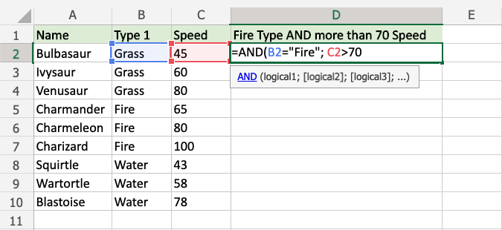
AND Function
The AND function is a premade function in Excel, which returns TRUE or FALSE based on two or more conditions.
It is typed =AND and takes two or more conditions.
Note: The AND function is often used together with the IF function.
=AND([logical1], [logical2], ...)

Slide 14
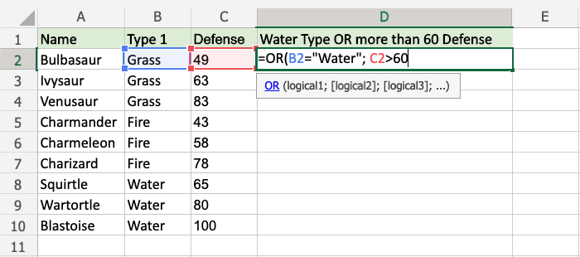
OR Function
The OR function is a premade function in Excel, which returns TRUE or FALSE based on two or more conditions.
It is typed =OR.
Note: The OR function is often used together with the IF function.
=OR([logical1], [logical2], ...)
The conditions are referred to as [logical1], [logical2], and so on.
The conditions can check things like:
If a number is greater than another number >
If a number is smaller than another number <
If a number or text is equal to something =

Slide 15
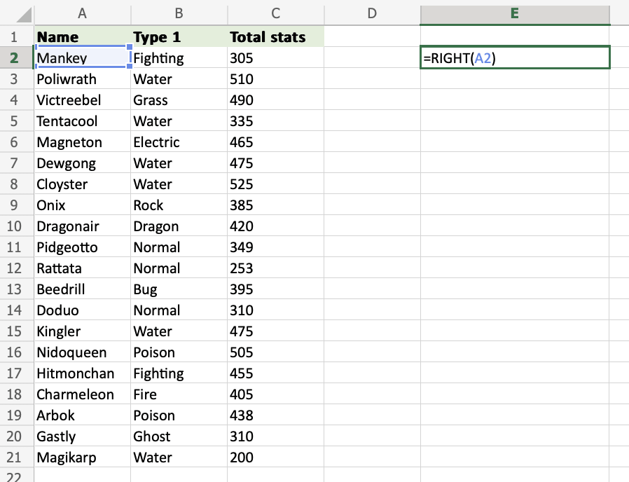
RIGHT Function
The RIGHT function is used to retrieve a chosen amount of characters, counting from the right side of an Excel cell. The chosen number has to be greater than 0 and is set to 1 by default.
It is typed =RIGHT
If you want to use the function on a single cell, write:
=RIGHT(cell)
If you want to use the function on a range of cells, write:
=RIGHT(start cell:end cell)

Slide 16
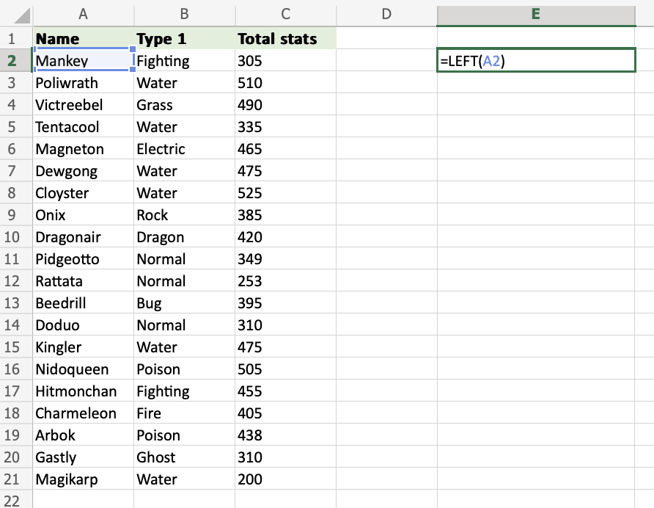
LEFT Function
The LEFT function is used to retrieve a chosen amount of characters, counting from the left side of an Excel cell. The chosen number has to be greater than 0 and is set to 1 by default.
It is typed =LEFT
If you want to use the function on a single cell, write:
=LEFT(cell)
If you want to use the function on a range of cells, write:
=LEFT(start cell:end cell)

Slide 17
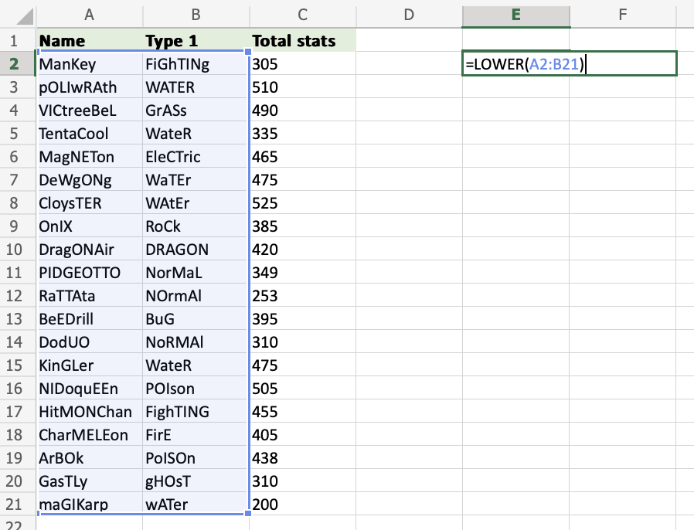
LOWER Function
The LOWER function is used to lowercase text in a cell.
Changing the letter case of your cell values can be great when there is a lot of case inconsistency among the cell inputs or when preparing your dataset for case-sensitive usage.
It is typed =LOWER
If you want to use the function on a single cell, write:
=LOWER(cell)
If you want to use the function on a range of cells, write:
=LOWER(start cell:end cell)

Slide 18
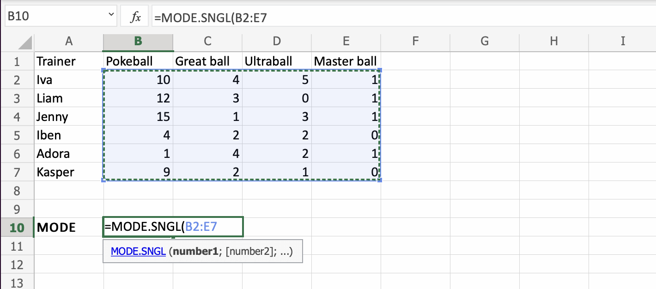
MODE Function
The MODE function is a premade function in Excel, which is used to find the number seen most times.
This function always returns a single number.
It is typed =MODE.SNGL
It returns the most occurring number in a range or array.
Note: The mode is a type of average value, which describes where most of the data is located. You can read more about mode in our: Statistics Mode Tutorial.
Let's have a look at an example where we help the Pokemon trainers to calculate the mode of numbers of Pokeballs.
How to use the =MODE function, step by step:
Select a cell (B10)
Type =MODE
Double click the MODE.SNGL command
Select a range (B2:E7)
Hit enter

Slide 19
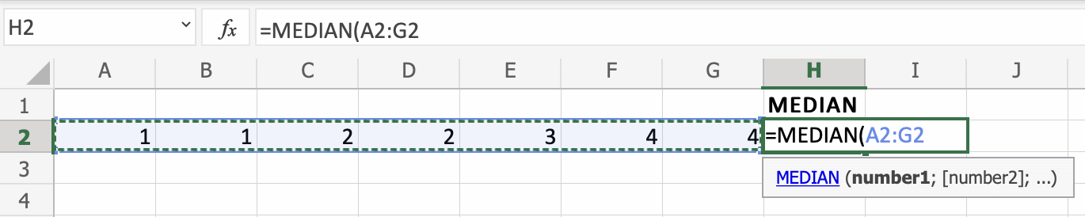
MEDIAN Function
The MEDIAN function is a premade function in Excel, which returns the middle value in the data.
It is typed =MEDIAN
Note: The median is a type of average value, which describes where the center of the data is located.
Calculating the median manually requires that the data is sorted and arranged from low to high. This is not necessary using the MEDIAN function, it does it for you.
How to use the =MEDIAN function, step by step:
Select a cell (H2)
Type =MEDIAN
Double click the MEDIAN command
Select a range (A2:G2)
Hit enter

Slide 20
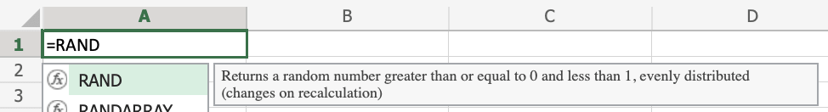


RAND Function
The RAND function is used to generate random numbers.
It is typed =RAND
Rand can be used to generate any random number.
You can define limits, create random data sets and much more.
To use the default RAND function, write:
=RAND()
To use the RAND function to receive a random number up to a certain value, write:
=RAND()*value
To use the RAND function to receive a whole number, write:
=INT(RAND())
How to Use RAND Function
To receive a random number, use RAND.
Step 1) Start the RAND function
Select a cell A1
Type =RAND
Double click the RAND command
Step 2) Close the function
Close the function with ())
Hit enter
The random number has been generated!

Slide 21


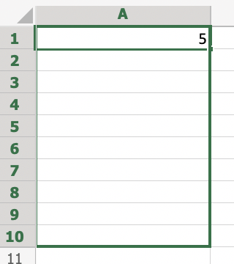
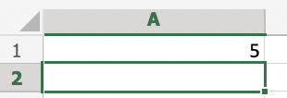
1. How to Use RAND Function With a Defined Limit Value.
Define the limit (*10)
Hit enter
2. How to Receive a Whole Number Using The RAND Function.
Add (INT) before the RAND function
Hit enter
3. How to Generate Multiple Random Numbers.
Drag the bottom right corner of the cell down to generate more numbers.
1
2
3

Slide 22
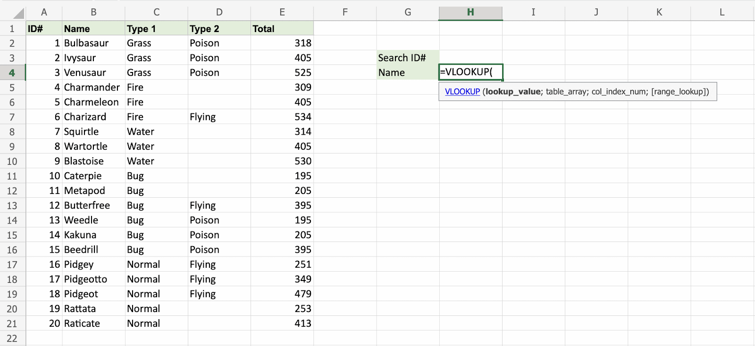
VLOOKUP Function
The VLOOKUP function is a premade function in Excel, which allows searches across columns.
It is typed =VLOOKUP and has the following parts:
=VLOOKUP(lookup_value, table_array, col_index_num, [range_lookup])
Note: The column which holds the data used to lookup must always be to the left.
The different parts of the function are separated by a symbol, like comma , or semicolon ;
Note: The column which holds the data used to lookup must always be to the left.
Lookup_value: Select the cell where search values will be entered.
Table_array: The table range, including all cells in the table.
Col_index_num: The data which is being looked up. The input is the number of the column, counted from the left:
How to use the VLOOKUP function.
Select a cell (H4)
Type =VLOOKUP
Double click the VLOOKUP command
Select the cell where search value will be entered (H3)
Type (,)
Mark table range (A2:E21)
Type (,)
Type the number of the column, counted from the left (2)
Type True (1) or False (0) (1)
Hit enter
Enter a value in the cell selected for the Lookup_value H3(7)

